Slide 1

ARTIFICIAL INTELLIGENCE
&
MACHINE LEARNING
SESSION NO : 6
Classical Search – Uninformed Search (Part 2)
UCS, IDS,Bidirectional Serach

Slide 2
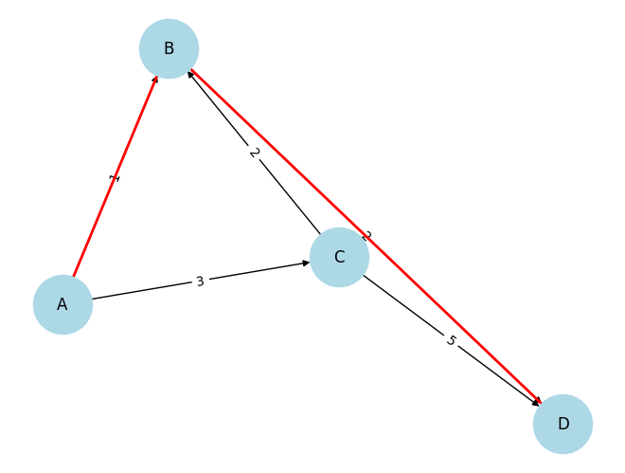
Uniform-Cost Search (UCS)
Uniform-Cost Search (UCS) extends Breadth-First Search (BFS) by considering path costs, always expanding the least-cost node first.
It guarantees finding the optimal path when all costs are non-negative.
Key Features:
Finds the least-cost path.
Slower than Breadth-First Search (BFS) in uniform cost cases.
Path from A to D : ['A', 'B', 'D']

Slide 3
Uniform-Cost Search (UCS) is a graph traversal algorithm used in path finding and artificial intelligence.
It is an uninformed (or blind) search strategy, meaning it does not use any domain-specific knowledge or heuristics.
It's a special case of Dijkstra’s Algorithm when applied to search problems.
Algorithm Steps
Start from the initial node and put it into a priority queue with cost 0.
While the queue is not empty:
  Remove the node with the lowest path cost.
  If this node is the goal, return the path.
  Otherwise, expand the node:
    For each successor, calculate the path cost.
    If the node is new or has a lower cost than previously found, add it to the queue.
If the queue is empty and the goal wasn't found, no solution exists.

Slide 4
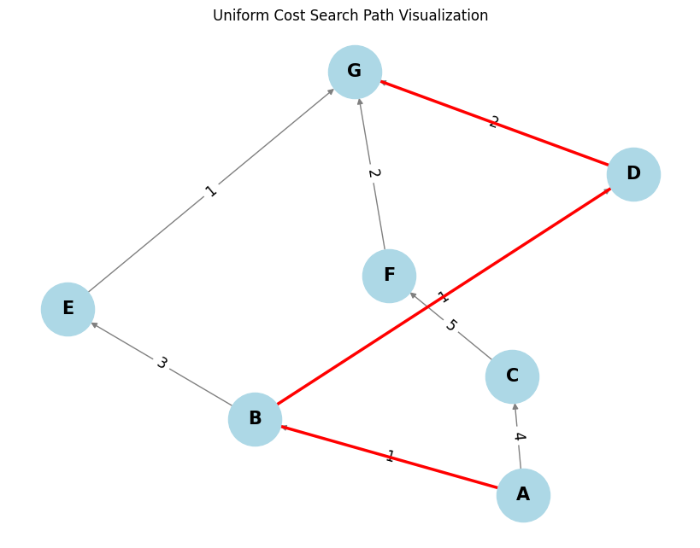

Slide 5
Graph Representation
graph = {
'A': [('B', 1), ('C', 4)],
'B': [('D', 1), ('E', 3)],
'C': [('F', 5)],
'D': [('G', 2)],
'E': [('G', 1)],
'F': [('G', 2)],
'G': []
}

Slide 6
1. Initialization:
Create a priority queue (frontier) and add the start node 'A' with a cost of 0.
Initialize a visited dictionary to keep track of the shortest path to each node.
2. Expansion and Exploration: The UCS algorithm operates by always selecting the node with the lowest cumulative cost from the start node from the priority queue.

Slide 7
1. Expand 'A' (Cost: 0):
Add 'B' (cost: 0+1=1) and 'C' (cost: 0+4=4) to the priority queue.
frontier = [(1, 'B'), (4, 'C')]
visited = {'A': (0, None), 'B': (1, 'A'), 'C': (4, 'A')}
2. Expand 'B' (Cost: 1): (Lowest cost in frontier)
Add 'D' (cost: 1+1=2) and 'E' (cost: 1+3=4) to the priority queue.
frontier = [(2, 'D'), (4, 'C'), (4, 'E')]
visited = {'A': (0, None), 'B': (1, 'A'), 'C': (4, 'A'), 'D': (2, 'B'), 'E': (4, 'B')}

Slide 8
3.Expand 'D' (Cost: 2): (Lowest cost in frontier)
Add 'G' (cost: 2+2=4) to the priority queue.
frontier = [(4, 'C'), (4, 'E'), (4, 'G')]
visited = {'A': (0, None), 'B': (1, 'A'), 'C': (4, 'A'), 'D': (2, 'B'), 'E': (4, 'B'), 'G': (4, 'D')}
4. Expand 'C' (Cost: 4): (Lowest cost in frontier)
Add 'F' (cost: 4+5=9) to the priority queue.
frontier = [(4, 'E'), (4, 'G'), (9, 'F')]
visited = {'A': (0, None), 'B': (1, 'A'), 'C': (4, 'A'), 'D': (2, 'B'), 'E': (4, 'B'), 'G': (4, 'D'), 'F': (9, 'C')}

Slide 9
5. Expand 'E' (Cost: 4): (Lowest cost in frontier)
Add 'G' (cost: 4+1=5) to the priority queue.
Since there's a new path to 'G' with cost 5 (less than the previous path cost of 4), update the cost of 'G' and reorder the priority queue accordingly. However, based on standard UCS behavior, this will only happen if the new path to G is better (smaller total cost). In this case, the prior path to 'G' had a cost of 4, so the new path with cost 5 will not be prioritized.
frontier = [(4, 'G'), (9, 'F')]
visited = {'A': (0, None), 'B': (1, 'A'), 'C': (4, 'A'), 'D': (2, 'B'), 'E': (4, 'B'), 'G': (4, 'D'), 'F': (9, 'C')}
6.Expand 'G' (Cost: 4): (Lowest cost in frontier, and it's the goal node)
Algorithm terminates as the goal node is reached with the lowest cost.
Result:
The algorithm found the path A -> B -> D -> G with a total cost of 4.

Slide 10
Advantages of UCS
Optimality Guaranteed
  UCS always finds the least-cost (optimal) path to the goal, assuming all step costs are non-negative.
Complete
  It is guaranteed to find a solution if one exists, as long as costs are ≥ some positive ε.
No Heuristics Needed
  Unlike A*, UCS doesn’t require domain-specific heuristics, making it easy to apply in unknown environments.
Handles Varying Costs
  Unlike BFS, which assumes uniform step costs, UCS works well even when action costs vary.

Slide 11
Disadvantages of UCS
High Memory Usage
  UCS stores all paths in memory, and the frontier (priority queue) can grow very large, especially for dense graphs.
Slow for Large or Deep Graphs
  It may expand many nodes with lower cost before reaching the goal, even if they are far from the goal (in depth or distance).
No Heuristic = No Goal Direction
  Since it doesn’t use heuristics, it might explore many irrelevant paths that don’t lead to the goal.
Inefficient in Some Cases
  In problems with large branching factors or many low-cost but irrelevant paths, UCS may be significantly slower than A* or other informed searches.

Slide 12
Applications of Uninformed Search Algorithm
Pathfinding: Used in navigation systems and robotics to find the shortest route between locations. BFS and DFS explore the map to determine the optimal path.
Puzzle Solving: Applied in problems like the Eight Puzzle or Fifteen Puzzle to determine a sequence of moves leading to a solution.
Game AI: Helps in exploring game trees to find winning strategies. BFS and DFS are often combined with minimax or alpha-beta pruning for efficiency.
Robot Navigation: Assists robots in path planning by exploring environments and identifying the best route while avoiding obstacles.
Web Crawling: BFS is widely used in web crawlers to systematically visit and index web pages by following links.

Slide 13
Iterative Deepening Depth-First Search (IDDFS)
IDDFS combines Breadth-First Search (BFS) and Depth First Search (DFS) by running Depth First Search (DFS) with increasing depth limits until a solution is found.
Key Features:
Ensures completeness and optimality like Breadth-First Search (BFS).
Uses less memory than Breadth-First Search (BFS).
Core Idea
IDDFS performs DFS repeatedly, increasing the depth limit by one each time.
First it explores depth 0, then depth 1, then 2, and so on...
At each iteration, it performs a depth-limited DFS.

Slide 14
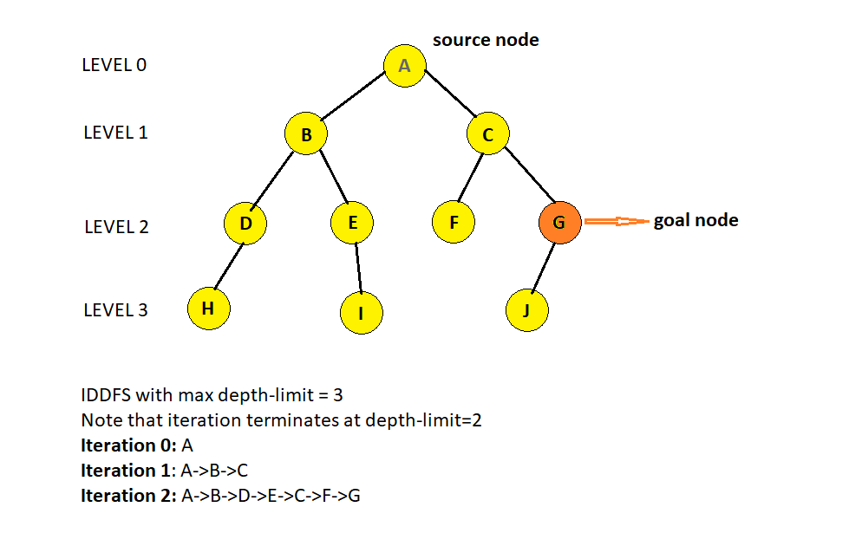
Algorithm Steps
Start with a depth limit = 0.
Run DFS with that limit.
If the goal is found, return the path.
If not, increase the depth limit and repeat.

Slide 15
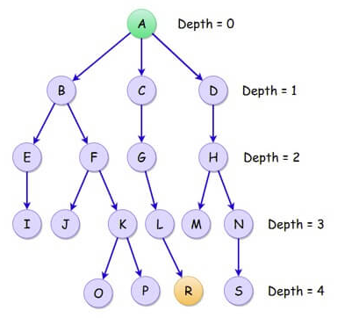
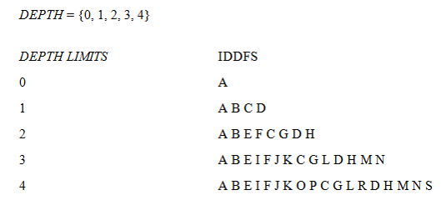

Slide 16
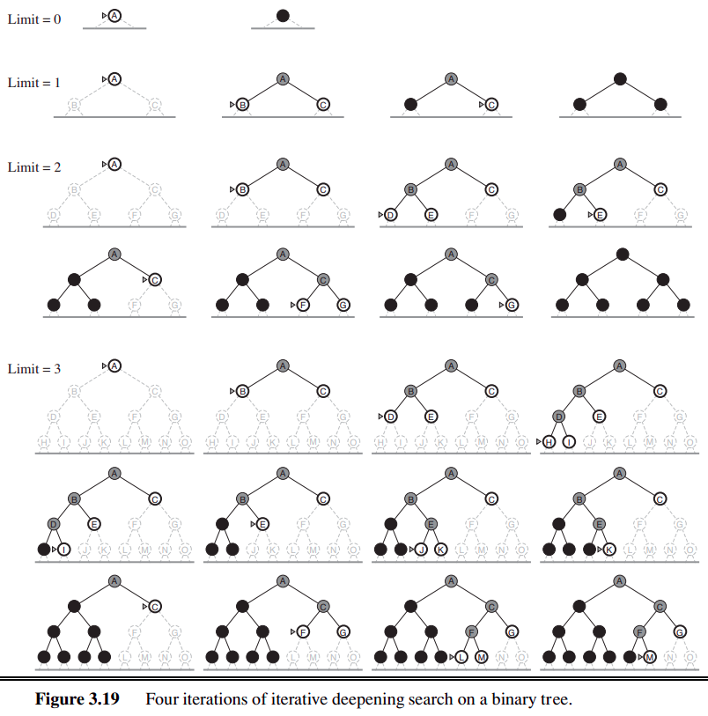

Slide 17
Pseudocode
def iddfs(start, goal, max_depth):
for depth in range(max_depth + 1):
found = dls(start, goal, depth)
if found:
return found
return None
def dls(node, goal, depth):
if depth == 0 and node == goal:
return [node]
elif depth > 0:
for child in get_successors(node):
path = dls(child, goal, depth - 1)
if path:
return [node] + path
return None

Slide 18
Advantages of IDDFS
Complete – Always finds a solution if one exists.
Optimal (in terms of depth) – Finds the shallowest goal node.
Low memory usage – Uses O(d) space, much less than BFS.
No need to set depth limit – Automatically increases depth.
Combines benefits of DFS and BFS – Memory efficiency of DFS + completeness of BFS.
Disadvantages of IDDFS
Repeated node exploration – Visits same nodes multiple times at shallower depths.
Inefficient for deep goals – Takes time repeating earlier levels.
Not suitable for weighted graphs – Does not consider path cost, only depth.
Slower than BFS in shallow goals – Overhead from repeated DFS calls.

